Slide 1
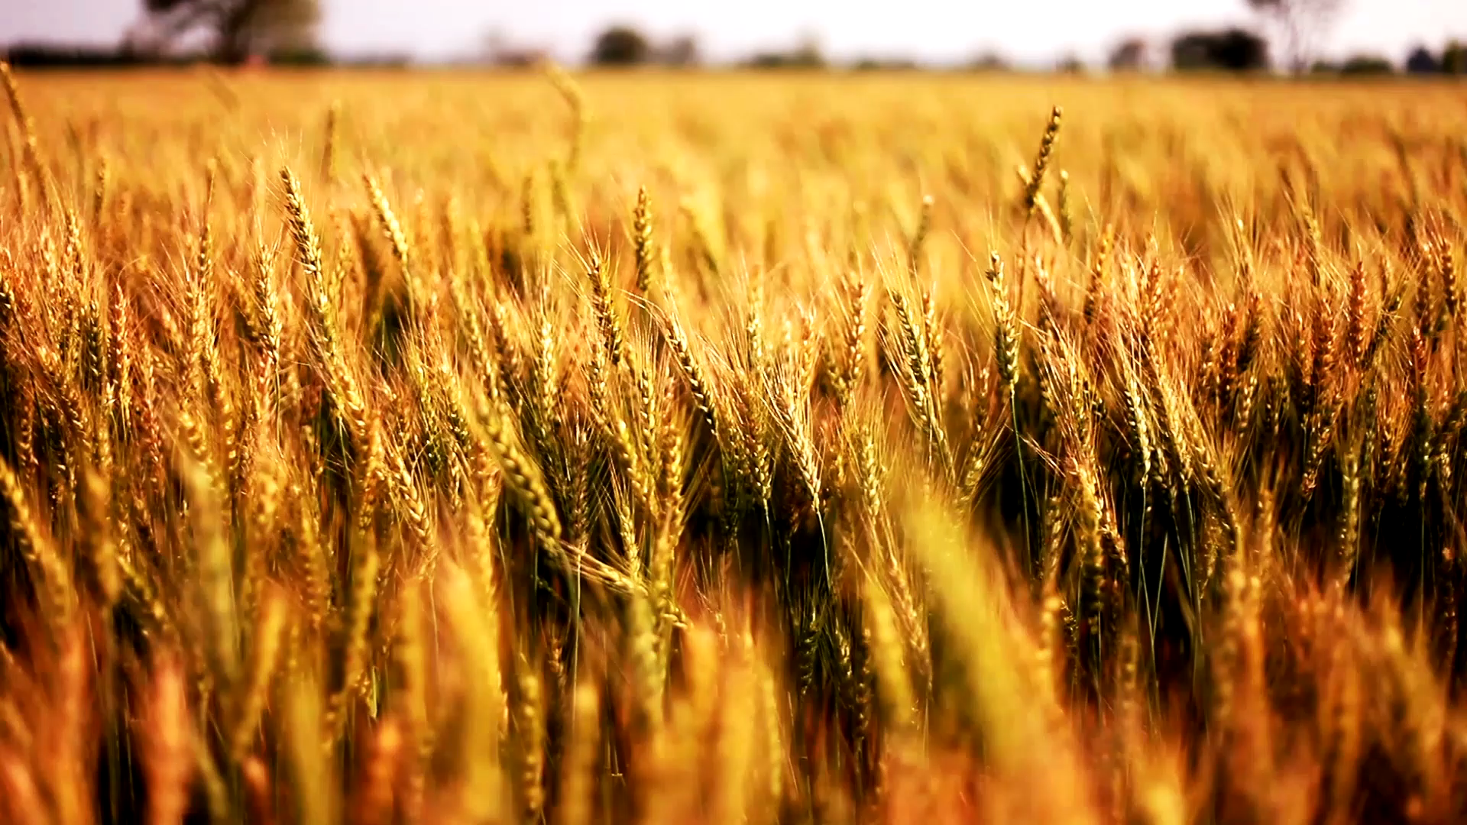
Climate change and Food Security Impact of climate change on Spoilage microbes
Team:- IMPACT MAKERS
Sawan, Yogita, Diya,Nancy,Samriddhi

Slide 2
Challenge
20-40% of the annual Global Crop yield is lost due to plant pathogens. Thus, exacerbating the food insecurity. The climate change is promoting the growth of these spoilage microbes.
These plant pathogens respond to changing climate in three keyways- multiplication, migration and evolution and are causing havoc in agriculture sector of different countries.

Slide 3
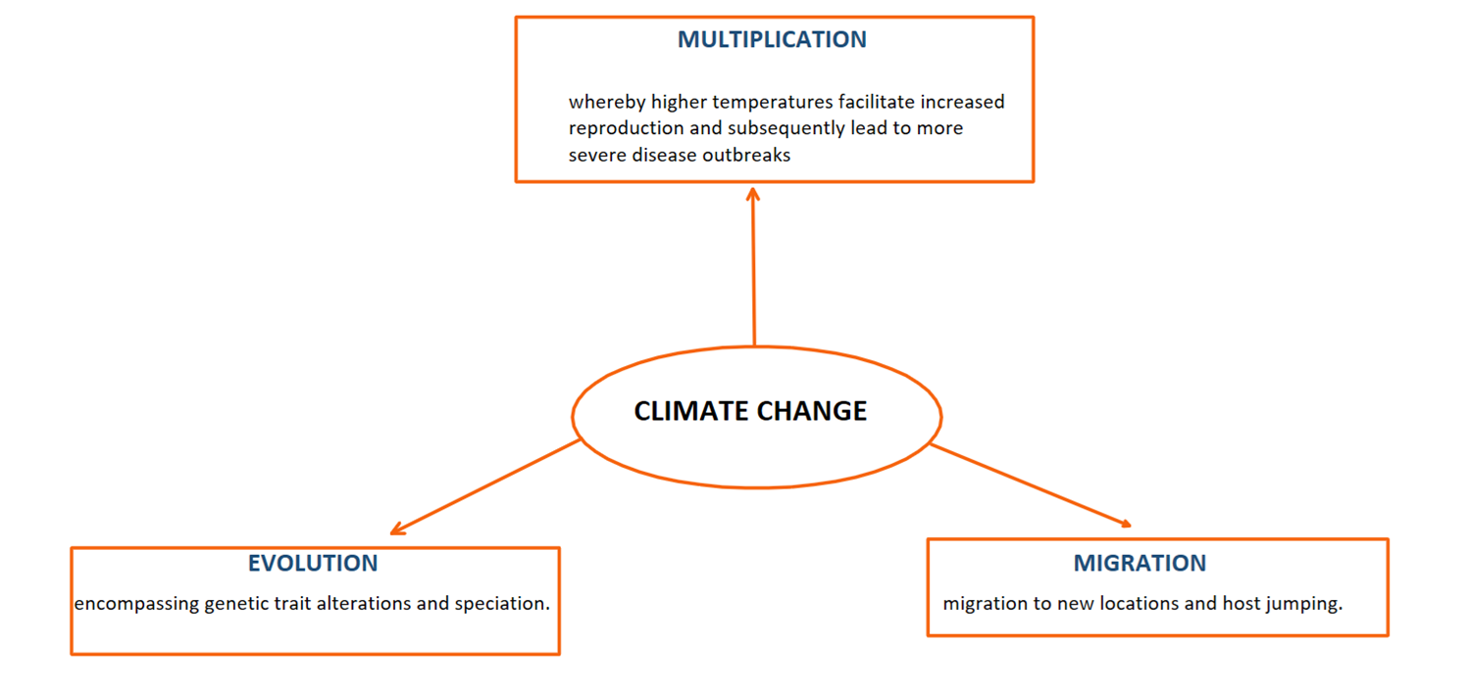
Effect of Climate on Plant Pathogens
Climate change affects the pathogen
In 3 ways:-

Slide 4
M
 | Causes | Pathogen | Disease | Crops Affected | Countries Affected | Comments
Multiplication | Due to increased temperature and humidity | Hemileia vastatrix | Coffee rust | Coffee | Colombia and Central America (2008–2013) | Increased temperature increased the pathogen population.
 | Due to increased temperature and humidity | Fusarium graminearum Fusarium culmorum | Fusarium head blight | Wheat | Global | Increased infection due to high abundance of conidia in soil and early anthesis of wheat.
 | Airborne | Phakopsora pachyrhizi | Asian soybean rust | Soybean | US | Hurricane Ivan caused the spread of spores leading to disease outbreak in the largest soybean-producing states.
 | Insect-borne | Chlorotic mottle virus spread by western corn rootworm, Diabrotica virgifera virgifera | Necrosis | Maize | Europe | Western corn worm is a native American species and is invading Europe.

Slide 5
 | Causes | Pathogen | Disease | Crops Affected | Countries | Comments
Migration | New hosts | Botrytis cinerea | Blossom blight | Japanese plums | Chile | First report on Japanese plums in 2013. It infected plums in California in 1960.
 | New location | Aspergillus section Flavi | Aflatoxin production | Maize | France, Europe | Originated in America and Africa and reported in France in 2013.
 | New location | Phytophthora infestans | Late blight | Potato, tomato | Europe | Led to the Irish famine in 19th century.
 | New location Speciation | Verticillium longisporum | Verticillium stripe | Canola and other brassica crops | Canada, Europe | Moving polewards. Recently reported in Canada.
 | New location Speciation | Botrytis sinoallii | Grey mold | Allium crops | China | New species of Botrytis found in province of China in 2010 due to increasing temperature.

Slide 6
 | Causes | Pathogen | Disease Name | Crops Affected | Countries Affected | Comments
Evolution | New Strains | Puccinia striiformis f. sp. tritici (Pst) | Stripe (yellow) rust | wheat | Global | New strains Pst 1 and Pst2 are very aggressive and virulent. Strain adapted to higher temperatures with shorter latency period and increased spore germination percentage.
 | New Strains | Puccinia graminis f. sp. tritici (Pgt) Race Ug99 | Stem (black) rust | wheat | Global | Race Ug99 is the most aggressive that was reported first in Africa and is virulent to the resistant gene Sr31.

Slide 7
Methodology
Collection of data on-
Impact of climate change on the growth of different spoilage organisms.
Average yield loss vs increase in temperature due to global warming from open literature and IPPC reports.
Summarization of data.
Regression analysis model of multiple variables to predict the impact of climate change on-
Growth of spoilage organisms.
Yield of crops.
Hike in prices of food products.

Slide 8
Tools used-
Semantic climate tools- pygetpapers, docanalysis (Google colab)
HTML online compiler.
Microsoft Office.
R Studio.

Slide 9
Role of IPCC reports
We retrieved the data from IPCC Chapter 5 (Food Security) on –
Global trends in yield of different crops.
Impact of climate change on the biology of contaminating organism.
Impact of climate change on the host crop plant.
Food price spikes.

Slide 10
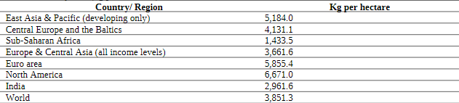
SURVEY
According to the most recent data released by IPCC, One of the biggest issues confronting Indian agriculture is low productivity. India’s cereal yields are drastically lower than those of developed regions such as North America (6671 kg per ha), East Asia and the Pacific (5,184 kg per ha), and the Euro area(5855.4 kg per ha)

Slide 11
Conclusion
Summarization of data on impact of climate change on spoilage microorganisms and yield of crops will help us in future research to find the optimum solutions.
Creating Regression analysis model of multiple variables to predict the impact of climate change on-
Growth of spoilage organisms.
Yield of crops.
Hike in prices of food products.
Predictive analysis can help farmers and farming businesses predict crop yield in a particular season, when to plant a crop, and when to harvest for better crop yield. Predictive analytics is a powerful tool that can help to improve decision-making in the agriculture industry.

Slide 12
Thank you

